Slide 1
A DEEP RL AGENT FOR PLAYING MEGA MAN ON NES
By Petrescu Alexandru
Notes:
Buna, Numele meu este Alex si am ales ca proiect sa fac un agent de reinforcement learning care sa joace jocul MegaMan pe un emulator de Nes.

Slide 2
ABSTRACT
The goal is to create a deep RL agent for playing the game Mega Man on Nes
The technologies are Python, stable-baselines3, numpy, cv2 and optuna
A combination of Deep Neural Networks and Reinforcement Learning Algorithms
Notes:
O sa intru in detalii legate de acest agent de reinforcement learning si cum functioneaza pe slideurile urmatoare.
Ca si tehnologii folosite, o sa incorporez tehnologii python cum ar fi stable-baselines3 pentru folosirea de algoritmi de Deep RL, numpy, cv2 pentru preprocesare de imagini si optuna pentru hyperparameter-tuning dar toate acestea vor fi explicate mai tarziu.
Ca si concepte, o sa vorbim despre retele neurale adanci, metode de preprocesare de reinforcement learning.

Slide 3
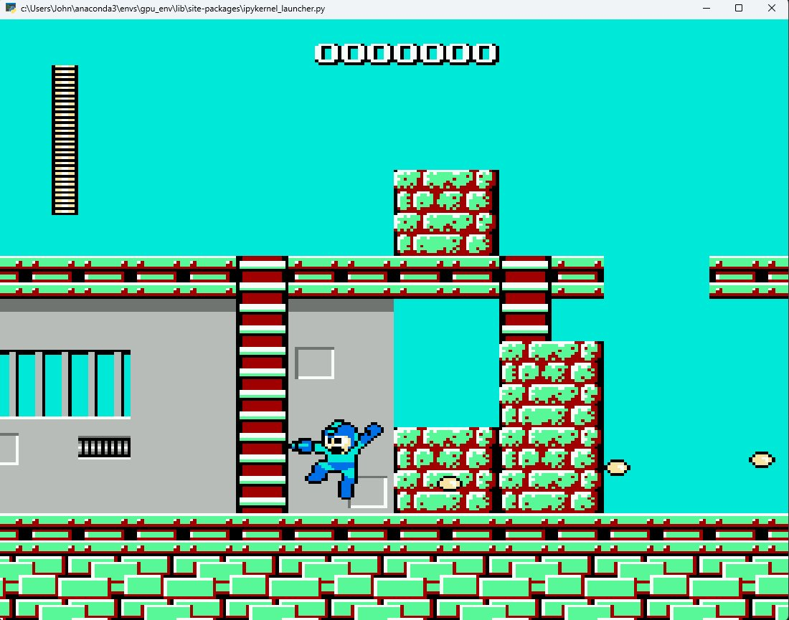
Notes:
Asa arata jocul nostru de megaman pe emulatorul de nes pe care o sa-l folosesc

Slide 4
Motivation
Deep RL has been used by DeepMind to train AlphaGo to beat the world champion at Go, Lee Sedol, achieving a 4 – 1 victory against him. The Agent has showcased moves that at the time have never been used by any other professional Go player and that have upturned the game in favour of the RL agent.
AlphaGo inspired the creation of AlphaZero which became even better at playing Chess, Shojin and Go than its predecessors.
OpenAI Five is a powerful Deep RL Multi-Agent program created by OpenAI which consists of 5 agents playing DOTA. In 2019, the team defeated a world champion team in a live match.
Notes:
Acum probabil va intrebati de ce am ales aceasta tema ca si proiect.
Desi Reinforcement Learningul are o istorie scurta, ea a fost impanzita de momente culminante in care agentii de reinforcement learning au dat dovada de o abilitate de gandire nemaintalnita.
De exemplu, compania DeepMind a folosit Deep RL ca sa antreneze un agent numit AlphaGo sa joace Go cat de bine posibil. El a fost antrenat initial pe o colectie de jocuri jucate de catre campioni de Go ca dupa sa se antreneze pe cont propriu, jucand meciuri de Go cu el insusi. Acest agent a ajuns la un nivel de experienta atat de mare incat a reusit sa-l bata pe Lee Sedol, campion mondial la Go, in 2016 cu un scor nemaipomenit de 4 – 1.
De asemenea, creatia de AlphaGo a fost folosita mai departe ca punct de plecare pentru crearea altui agent de RL AlphaZero care a reusit sa invete sa joace mai bine Go decat precedentul sau si chiar sa joace foarte bune si jocuri precum sah si shojin, care e sahul japonez.
O alta instanta uimitoare a folosirii tehnologiilor de RL in domeniul jocurilor video a fost atunci OpenAI a creat un Multi-Agent program care sa fie antrenat pentru a juca jocuri de DOTA in echipe de 5 jucatori. In 2019, acest Multi-Agent program a invins o echipa mondiala de DOTA intr-un live match. Algoritmul folosit pentru antrenarea acestui program a fost PPO, acelasi algoritm pe care o sa-l folosesc si eu ca sa-mi antrenez agentul sa joace MegaMan.

Slide 5
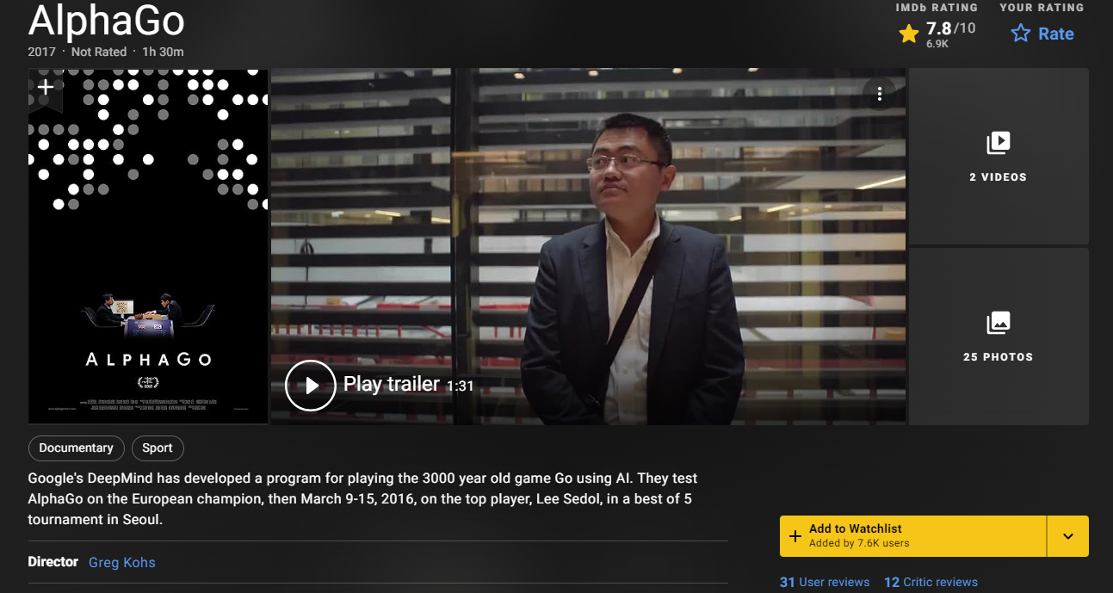
Notes:
Aceasta instanta in care un agent de Deep RL a reusit sa invinga un campion mondial de Go a fost atat de populara incat a inspirat crearea unui documentar de succes intitulat cu acelasi nume.

Slide 6
WHAT IS REINFORCEMENT LEARNING REALLY??
Notes:
Dar care e faza cu acest de tip de invatare numit Reinforcement Learning.

Slide 7

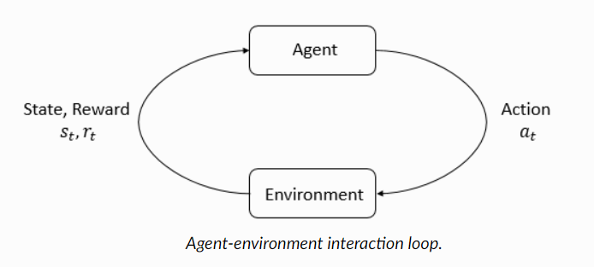
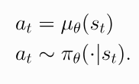
Notes:
Reinforcement Learning-ul se bazeaza pe cateva concepte cheie. Scenariul in care aplicam acest tip de invatare cuprinde un agent, care este un program ce ia o actiune a la un moment t in cadrul unui environment.
In urma actiunii luate, environmentul isi modifica starea globala si returneaza ca si raspuns o noua stare si un reward pe care agentul il primeste ca si input si in urma cauria alege o alta actiune si ciclul se repeta pana cand agentul a ajuns la scopul dorit sau este fortat sa se opreasca de catre environment. Un reward pozitiv o sa incurajeze agentul sa ia actiuni asemanatoare cu cea luata si in viitor iar o actiune negativa o sa penalizeze agentul pentru luarea aceleiasi decizii, determinand-ul pe agent sa incerce alte strategii pentru a ajunge la scopul final.

Slide 8
AGENT

Slide 9
ACTIONS
Key Arrows
Space (Jump)
AGENT
Shoot
Use Special Power

Slide 10
REWARD
ACTIONS
Key Arrows
Space (Jump)
AGENT
Shoot
Use Special Power
ENVIRONMENT

Slide 11
REWARD
ACTIONS
HEALTH
Key Arrows
Space (Jump)
AGENT
Shoot
Use Special Power
ENVIRONMENT

Slide 12
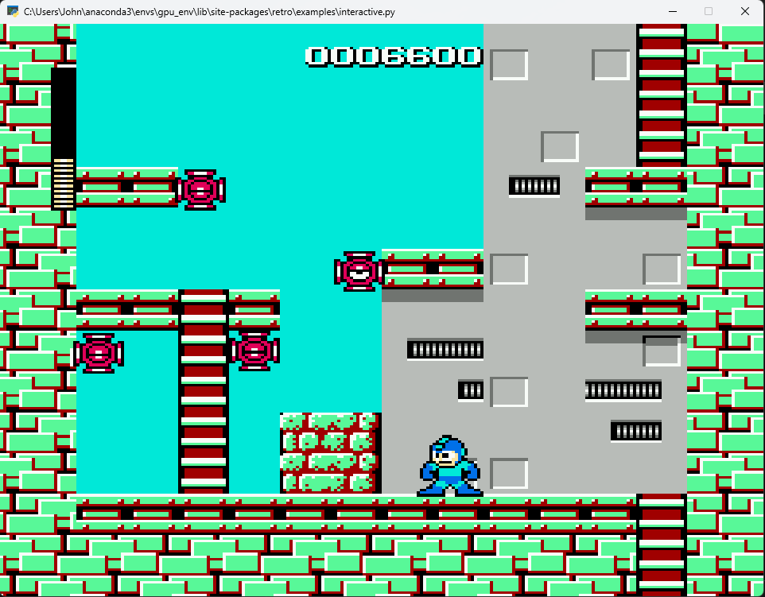
ENEMY

Slide 13
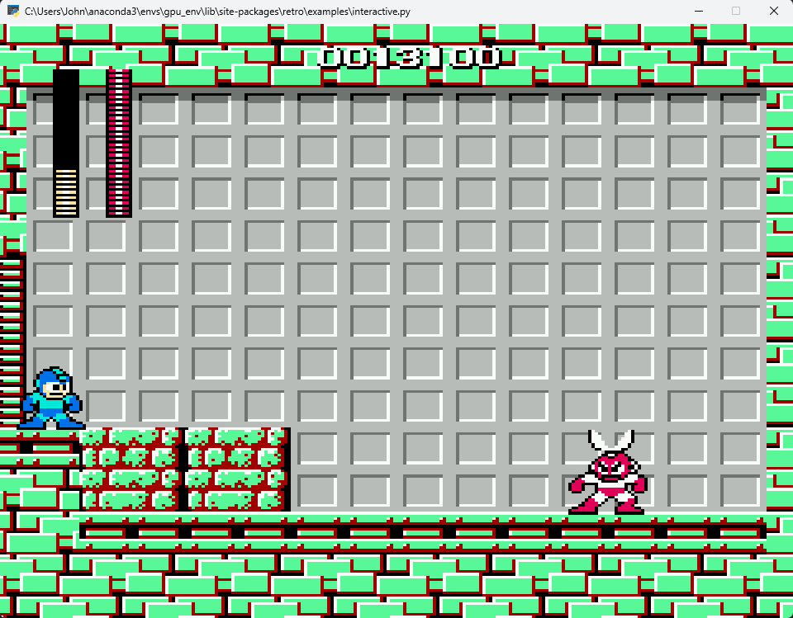
BOSS

Slide 14
WHAT WE EMPLOY AND WHY

Slide 15
PREPROCESSING
Every good RL model needs to be fed with quality and low in memory data. The more concise and precise the data are, the more performant and reliable our Deep RL model will be.
Out observation will be comprised of a stack of the latest 4 frames for our model to be able to detect motion in our agent and be able to learn the patterns of the enemies. Since our images are made in the RGB channels and have pretty large dimensions, we will grayscale and rescale them such that the amount of memory is much less than the initial one. We will also use frame-skipping in order to reduce the amount of computations that need to be done by the neural network.
Notes:
Orice agent bun de Reinforcement Learning trebuie sa primeasca ca si input niste stari care sa fie cat mai mici dar sa contina informatii cat mai importante pentru indeplinirea scopului ales.
Observatiile, sau starile, pe care agentul le primeste ca si input o sa fie formate din ultimele 4 frame-uri ale environmentului ca modelul de Deep RL sa fie in stare sa detecteze miscare in agent si sa invete patternurile de atac ale inamicilor.
Din moment ce imaginile noastre sunt destul de mari si pixelii sunt reprezentati in modul RGB, o sa folosim tehnici de grayscaling si rescaling pentru a reduce dimensiunea inputului semnificativ. De asemenea vom folosi si frame-skipping ca sa reducem cantitatea de putere computationala pe care reteaua de antrenare o foloseste.

Slide 16
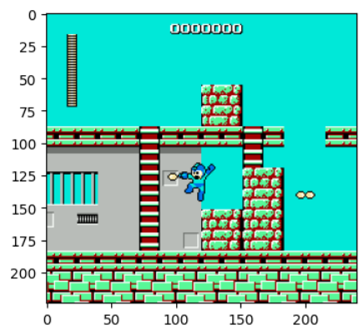
BEFORE PREPROCESSING
224 x 240 x 3 values ( bytes)

Slide 17
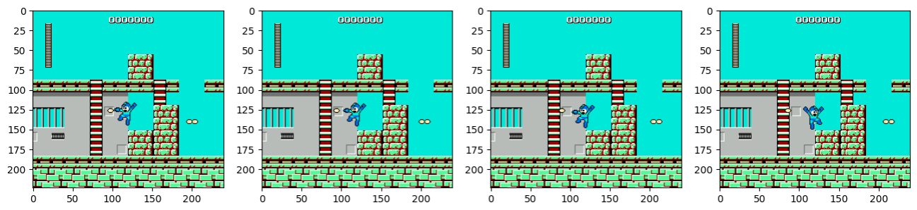
AFTER FRAME STACKING
224 x 240 x 12 values ( bytes)

Slide 18
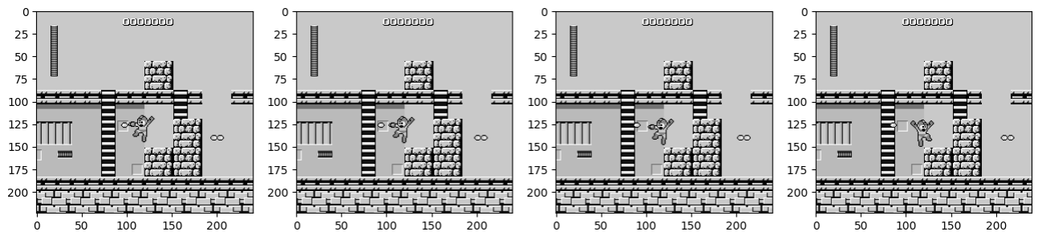
AFTER GRAYSCALING
224 x 240 x 4 values ( bytes)

Slide 19
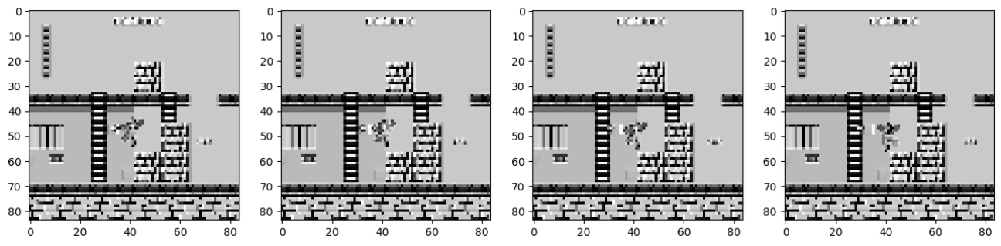
AFTER RESCALING
84 x 82 x 4 values ( bytes)

Slide 20
240 x 240 x 12
240 x 240 x 4
84 x 84 x 4
691,200
230,400
28,224
25 times less memory than initial

Slide 21
TO NOT FORGET TO NORMALIZE THE OBSERVATION VALUES !

Slide 22
POLICY AND TRAINING
We will use the basic concepts of Reinforcement Learning together with the concept of Multi-layer perceptron (MLP) where the input layer is made of the observation of the environment at the current step, the hidden layers are convolutions and pooling operations with linear combinations and activation function layers and the output layer represents the logits of the policy that is based on the weights of the neural network.
At the end, we use a softmax operation to reduce the logits to probabilities that specify the likelihood of an action being taken based on the current policy we are using. The purpose of the neural network will be to maximize the expected return value by modifying the weights of the MLP.

Slide 23
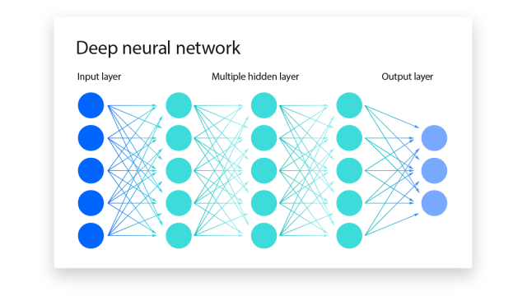
OBSERVATION
θ₁
θ₂
θ₃
o_{t, 1}
softmax
o_{t, 2}
P_{t, 1}
...
P_{t, 2}
...
P_{t, 3}
o_{t, 28,224}
P_{t, i} = probability to take action i at time step t

Slide 24



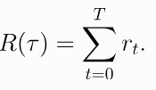
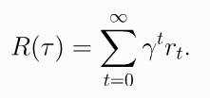
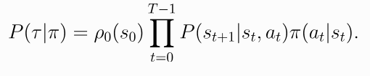

FORMULAS
finite-horizon undiscounted return
infinite-horizon undiscounted return
With 0 < γ < 1

Slide 25

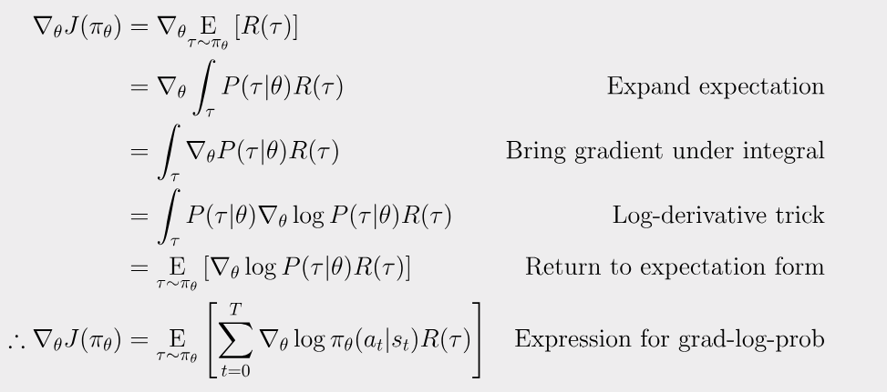
GRADIENT ASCEND

Slide 26
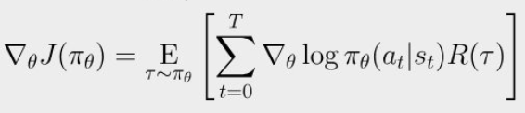
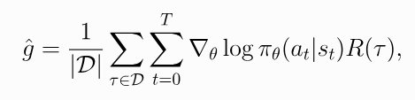
POLICY GRADIENT:
SIMPLEST DERIVATION OF POLICY GRADIENT

Slide 27
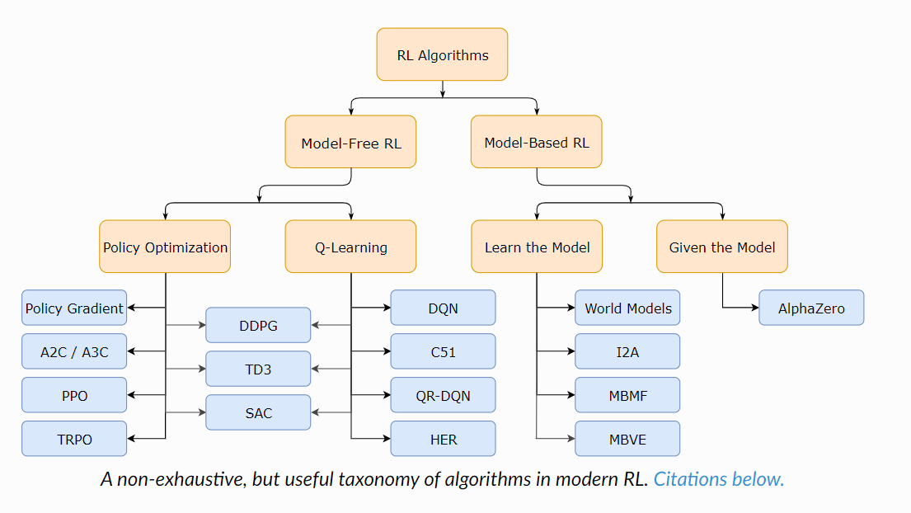
TAXONOMY OF RL ALGORITHMS

Slide 28
POLICY AND TRAINING
The algorithm we will be using is PPO or Proximal Policy Optimization. It is based on VPG and TRPO but uses a few new tricks to keep the new policy close enough to the old policy in order to not cause a performance collapse.
PPO methods are significantly simpler to implement, and empirically seem to perform at least as well as TRPO.
Since PPO is sample inefficient, the best way to assure its training is optimal is to increase its budget to at least 2-3 million steps, making sure that it start converging towards the end of the training phase

Slide 29
POLICY AND TRAINING
Another way to assure its efficacity is to choose a reasonable set of hyperparameters such as learning rate, n steps, clip range and gae lambda whose change have a great impact upon the overall performance of the model.
Unfortunately, there isn't a one-size-fits-all set of hyperparameters that will work for all the possible environments and rules of the game so you have to go through trial and error until you find the best combination of possible hyperparameters.
Another way to overcome this issue is to use an automatic hyperparameter tuning library like optuna to find iteratively the best possible set of hyperparameters

Slide 30
POSSIBLE OPTIMIZATIONS
MegaMan is a complex game since you have multiple levels, every level having a certain landscape, obstacles, enemies and bosses. Furthermore, After defeating the boss of the current level, you acquire his power which you can use to clear a level much easier than you would normally do if you used only your initial power.
Because of the large of amount of information and the difference in difficulty between different levels and bosses, we can use curriculum learning and reward shaping in order to leverage the uniqueness of every level and also we can use the SubprocVecEnv wrapper from stable_baselines3 in order to train our agent on multiple environments at the same time, thus significantly reducing our training time.

Slide 31
THANK YOU!

